Slide 1
Lists in HTML
Name: Dendup Tshering
Student No: 05220170
Module Code: SYS207

Slide 2
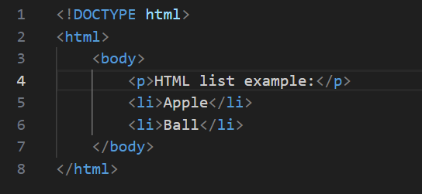
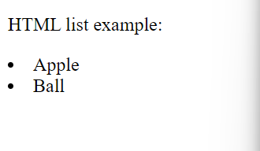
Introduction
HTML lists allow web developers to group a set of related items in lists.
Each list item starts with <li> tag.

Slide 3
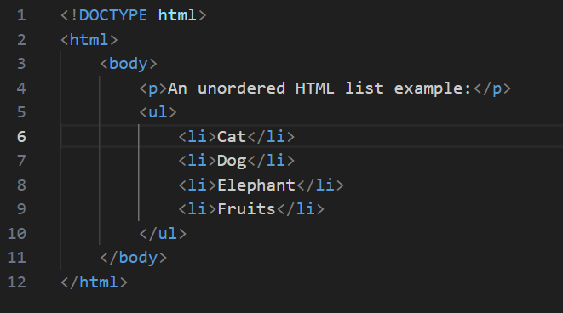
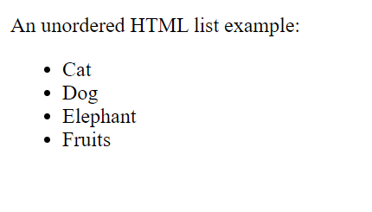
1. Unordered Lists
An unordered list starts with the <ul> tag.
The list items will be marked with bullets (small back circle) by default.

Slide 4
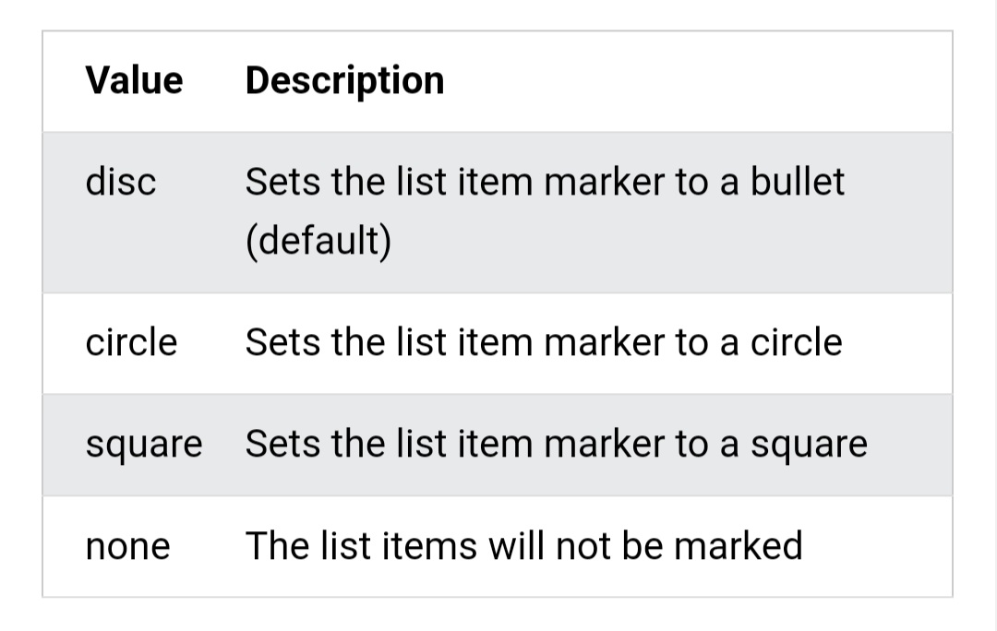
Unordered List – Choosing List Item Marker
The CSS list-style-type property is used to define the style of the list item marker.

Slide 5
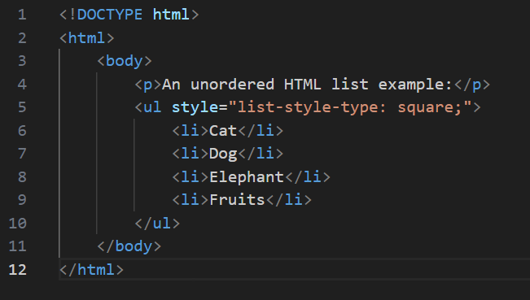
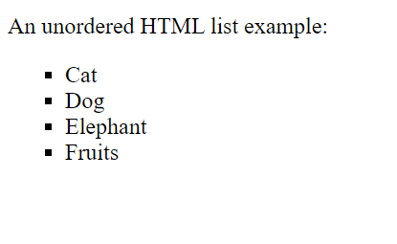

Slide 6
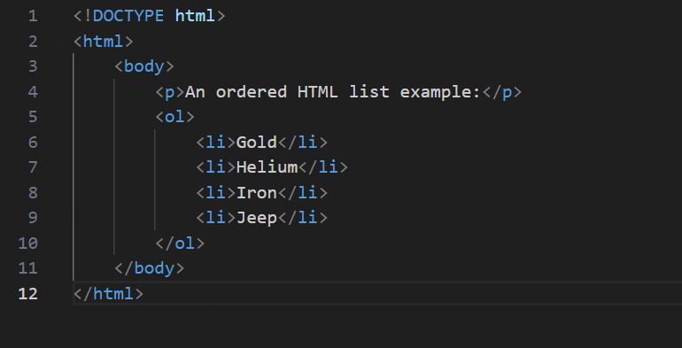
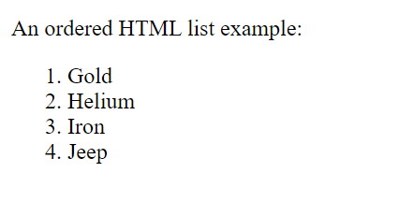
2. Ordered Lists
An ordered list starts with the <ol> tag.
The list items will be marked with numbers by default.

Slide 7
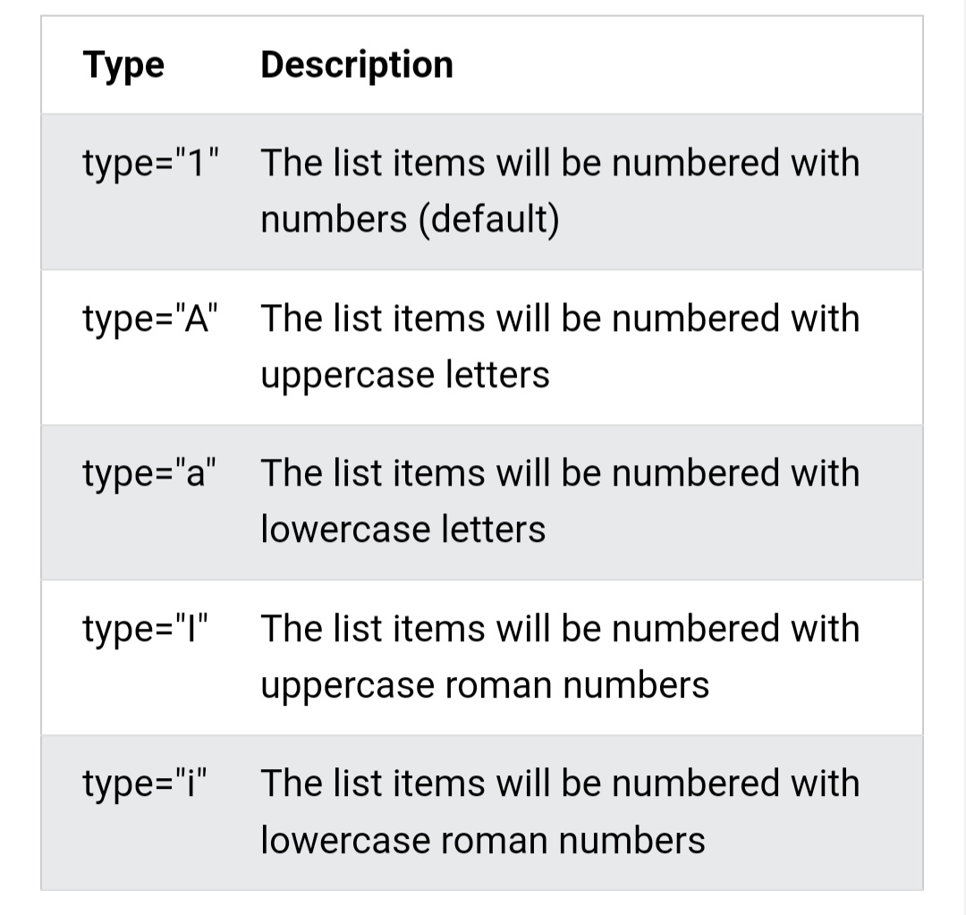
Ordered List – The Type Attribute
The type attribute of the <ol> tag defines the type of the list item marker.

Slide 8
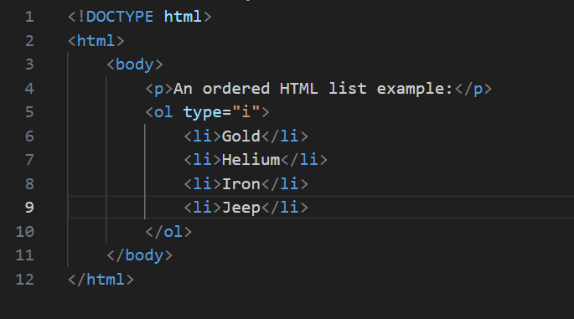
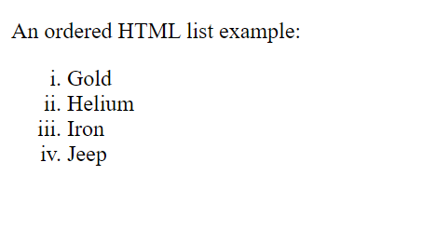

Slide 9
Control List Counting
By default, an ordered list will start counting from 1.
If you want to start counting from a specific number, you can use the start attribute.

Slide 10
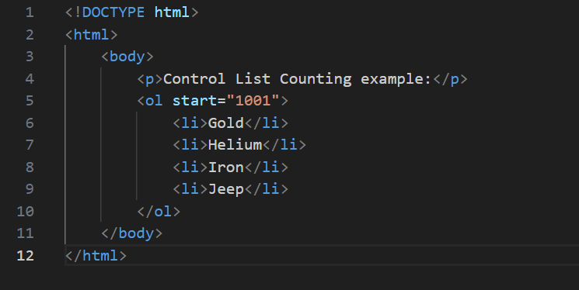
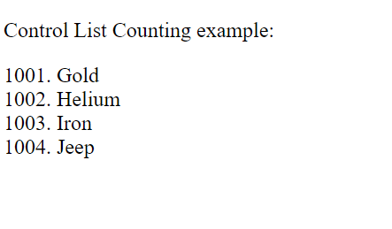

Slide 11
3. Nested HTML Lists
An unordered/ordered lists can be nested inside an unordered/ordered lists. Either way is possible.
Example of nesting an ordered lists inside an unordered lists:

Slide 12
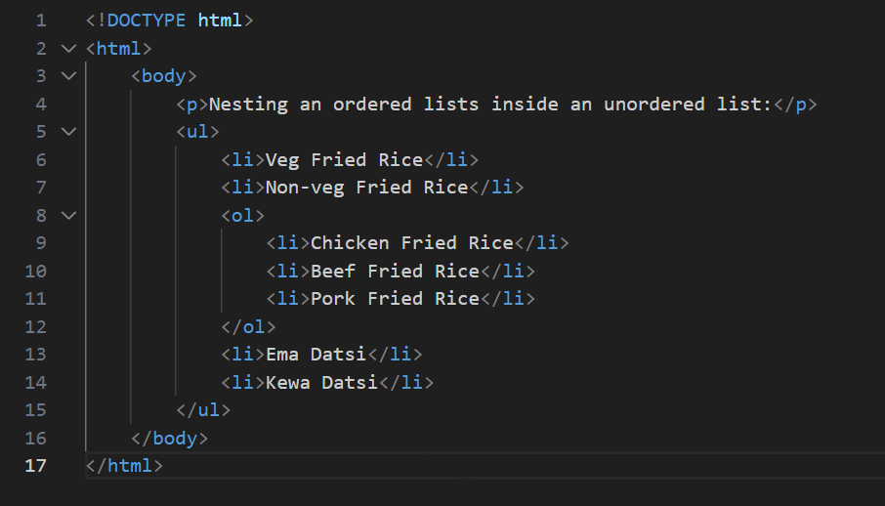
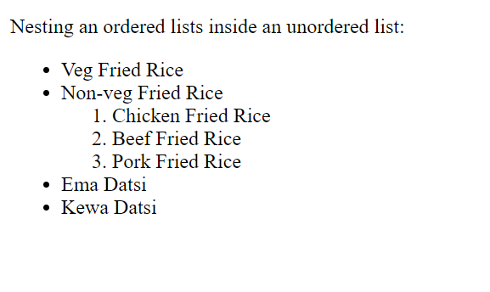

Slide 13
THANK YOU

